Slide 1

NYC Trip Fare Prediction Using Temporal Convolutional Networks (TCN)
Submitted by,
Md Nafiur Rahman Konok ID:20200104030
Arafat Islam Shopnil ID:20200104031
Yasir Arafah Prince ID:20200104042
Sumaiya Shejin ID:20200104043

Slide 2
Introduction
01
Proposed Solution
Key Benifit
Approach using Temporal Convolutional Networks (TCN) combined with time series analysis
Incorporates temporal variables like day of the week, time of day, and month
Models complex fare patterns, including traffic, demand surges, and trip features
Improved prediction accuracy compared to traditional methods
Demonstrates CNNs' capability in handling multimodal datasets
Potential for smarter resource allocation, optimized routes, and higher passenger satisfaction

Slide 3

02
Objective
Understand the nature of the dataset
Demonstrate wider usefulness of CNNs in processing NYC trip and fare dataset
Time-series analysis on NYC trip and fare dataset

Slide 4
Related Work
03
Paper-1: Antoniades et al. (2020)
Predicted taxi fare and ride duration using Linear Regression, Lasso, and Random Forest
Features: pickup/dropoff coordinates, trip distance, time
Best model: Random Forest

Slide 5
Related Work
04
Paper-2: Chou et al. (2021)
Fare prediction: Ensemble model (Linear Regression, Ridge Regression, Multilayer Perceptron)
Developed hybrid models for taxi demand and fare prediction
Taxi demand: LSTM-RNN with Mixture Density Network (MDN)

Slide 6
Related Work
05
Paper-3: Poongodi et al. (2019)
Predicted taxi trip durations using Multi-Layer Perceptron (MLP) and Extreme Gradient Boosting (XGBoost)
MLP showed lower accuracy compared to XGBoost
Best model: XGBoost

Slide 7
Dataset
06
Dataset Categories
Source
Trip Data
12 CSV files
Each file contains 14,776,615 rows & 14 columns
Fare Data
12 CSV files
Each file contains 14,776,615 rows & 11 columns
NYC taxi trip and fare data from the year 2013

Slide 8
Methodology
07
Geospatial Analysis
Key Metrics Analyzed
Fare Insights
Time-Based Patterns
Pickup and drop-off locations
Trip distances
Average fare amounts
Pickup and drop-off pairs
Highest and lowest fares
Payment behaviors
Average fare by payment type
Average trip distance by payment type
Trip duration distribution
Average total amounts

Slide 9
Methodology
08
Geospatial Analysis
Passenger Count
Insights
Value to Operations
Highest and lowest fares
Payment behaviors
Average fare by payment type
Average trip distance by payment type
Average trip distance for different passenger counts

Slide 10
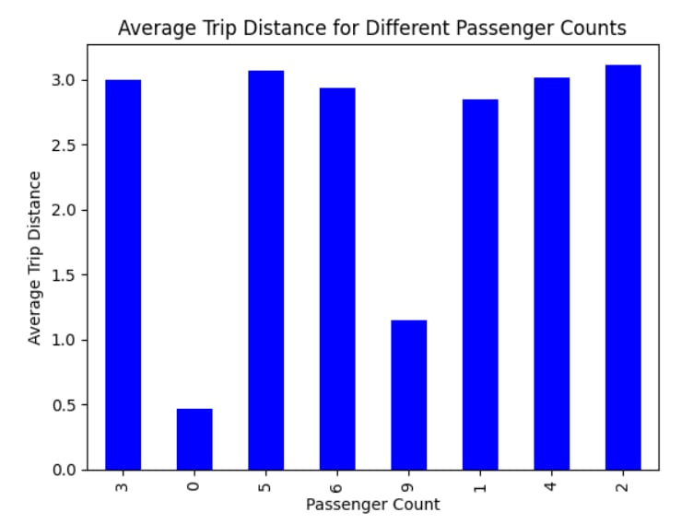
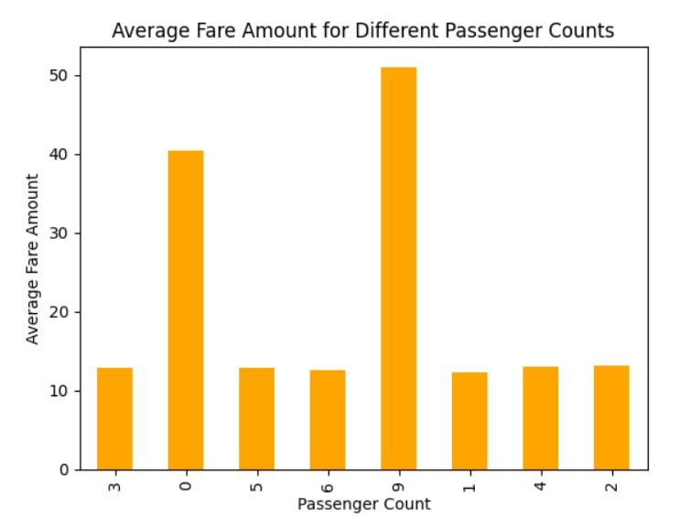
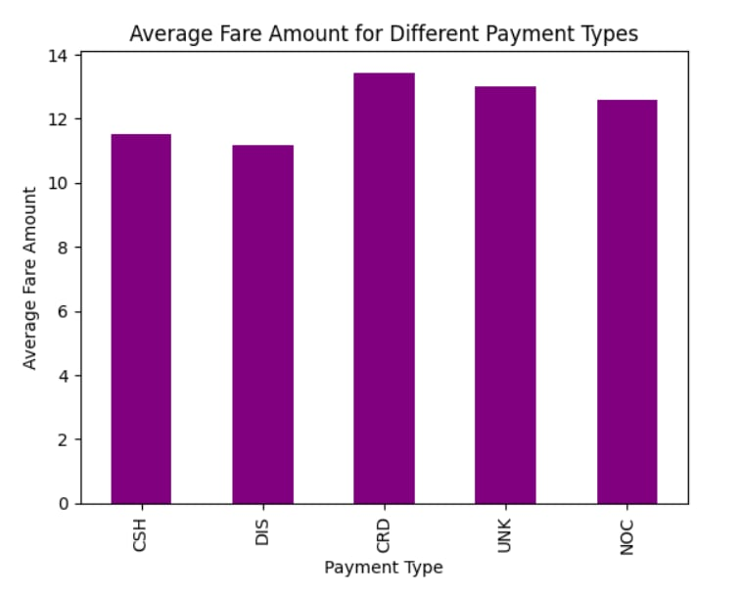
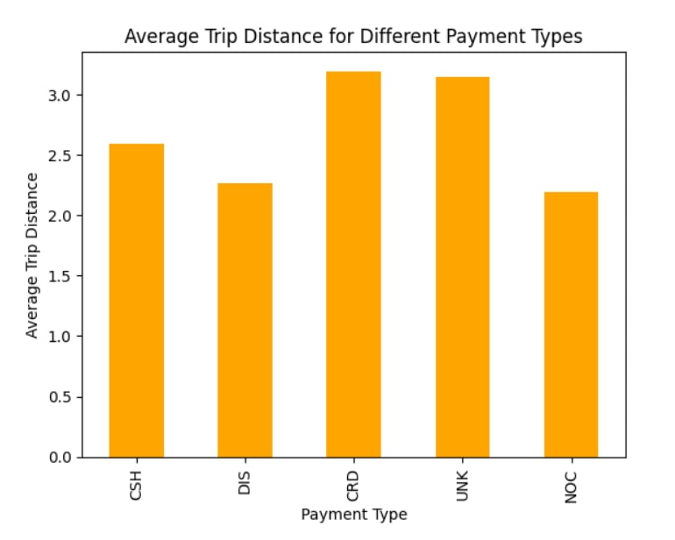
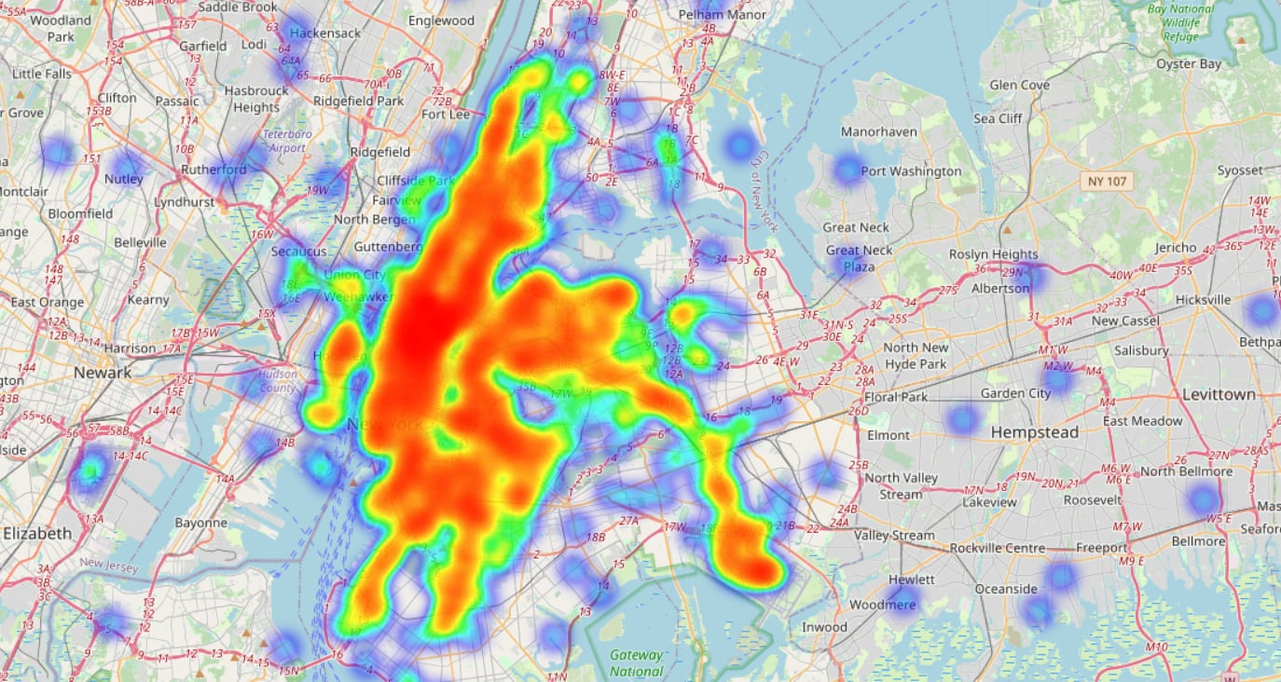
Methodology
09
Geospatial Analysis

Slide 11
Methodology
10
Time-series Analysis
Peak Hour Insights
Revenue and Payment Patterns
Trip Duration and Tip Behavior
Peak hours
Average passenger count by hour
Highest revenue-generating hours
Payment type variations
Drop-off times by hour
Tip amounts by hour

Slide 12
Methodology
11
Time-series Analysis
Daily Travel Patterns
Fare Trends and Popular Locations
Trip Distance Analysis
Pickup and drop-off variations by day of the week
Weekday vs. weekend pickup hours
Average fare amounts by hour
Most popular pickup locations by hour
Trip distance variations by pickup location and time of day
Average trip distance by hour

Slide 13
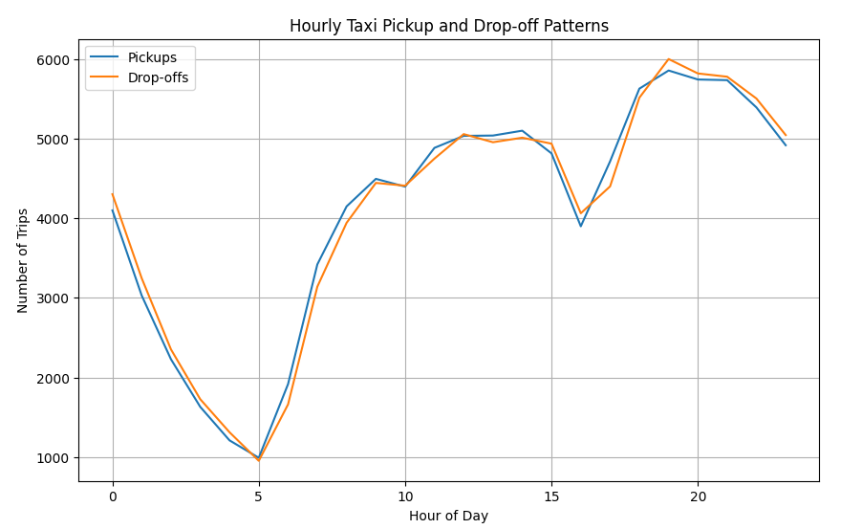
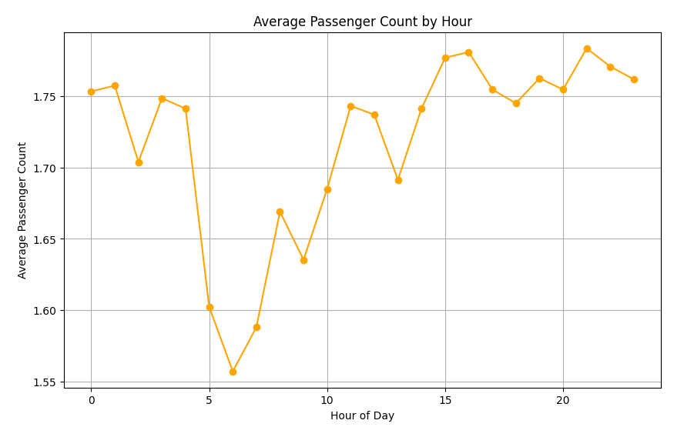
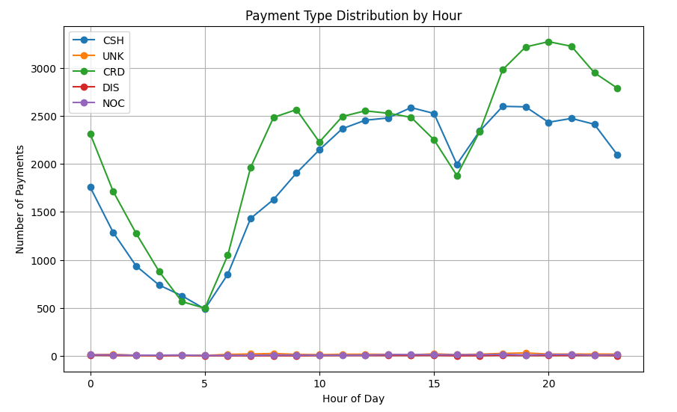
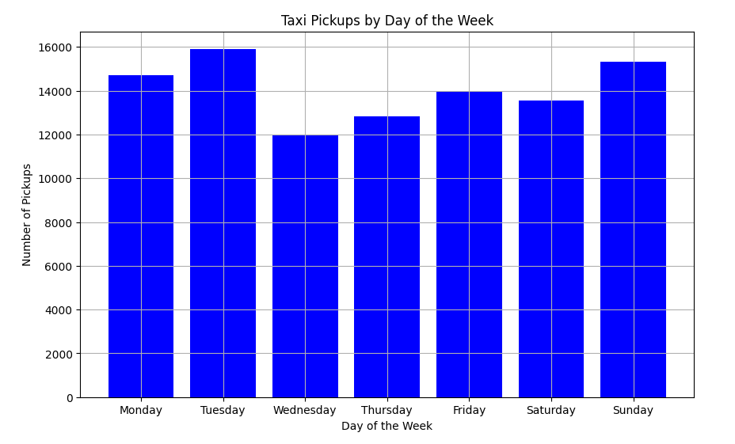
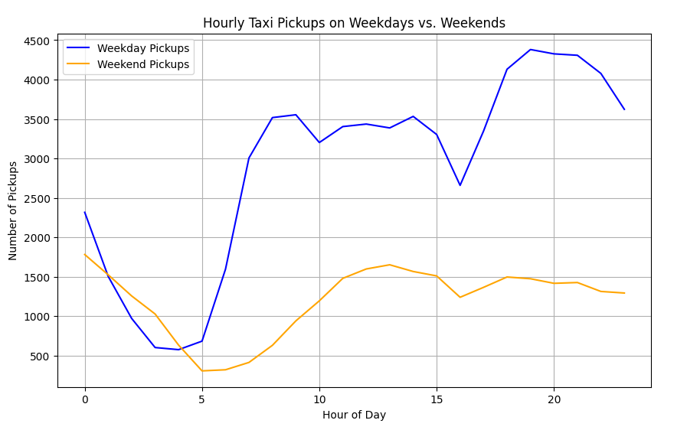
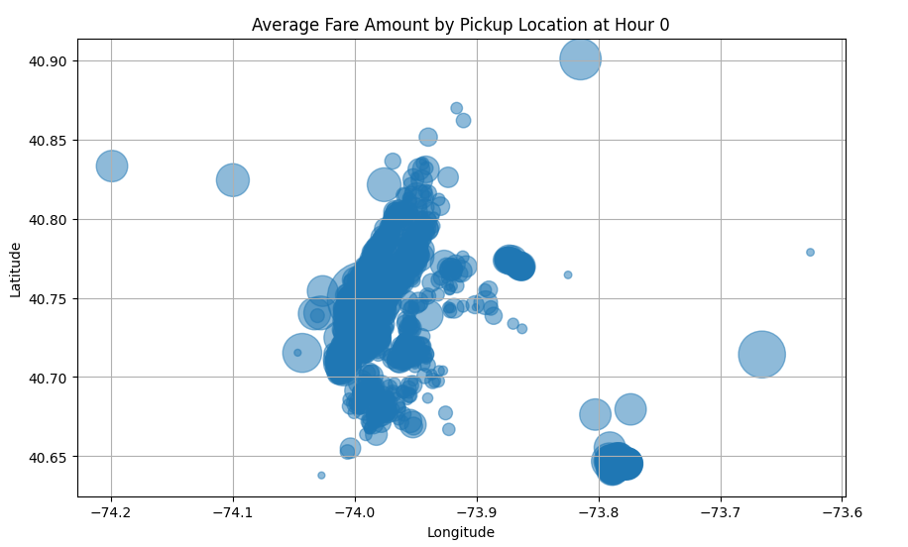
Methodology
12
Time-series Analysis

Slide 14
Result Analysis
13
Model - TCN
Strong Generalization & Convergence
Prediction Accuracy
Model Performance
Training and validation losses stabilized around 15 MSE
Low validation loss indicates the model generalized well to unseen data
Predicted fare amounts closely followed actual fare trends
Successfully captured temporal patterns in the data
Stable loss behavior across epochs reflects effective learning of temporal features
Model shows potential for improving urban mobility solutions by enhancing fare prediction accuracy

Slide 15
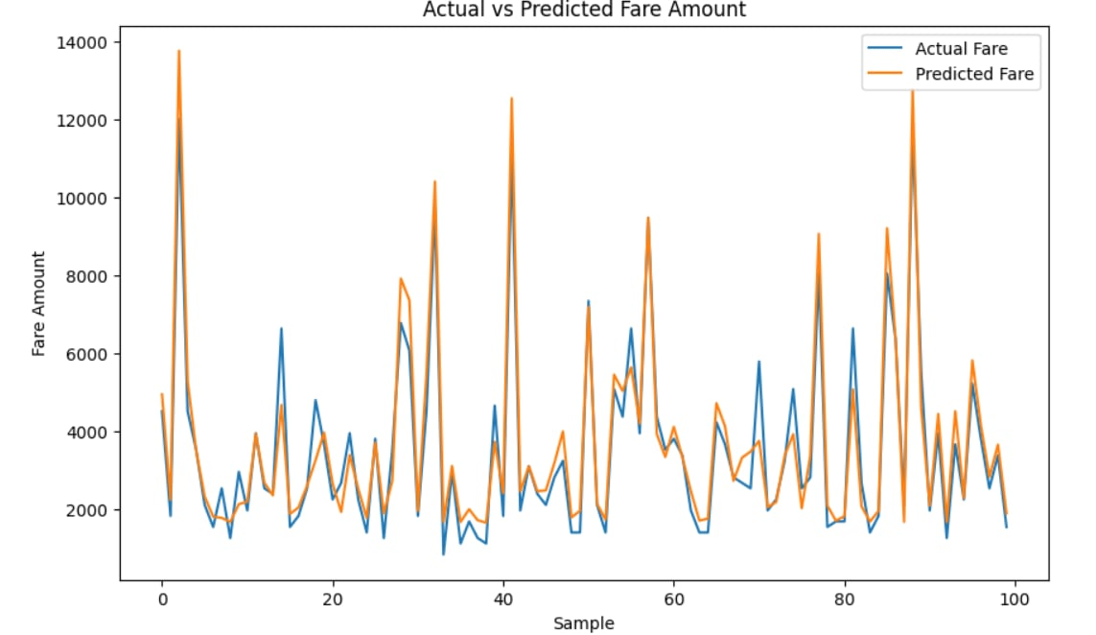
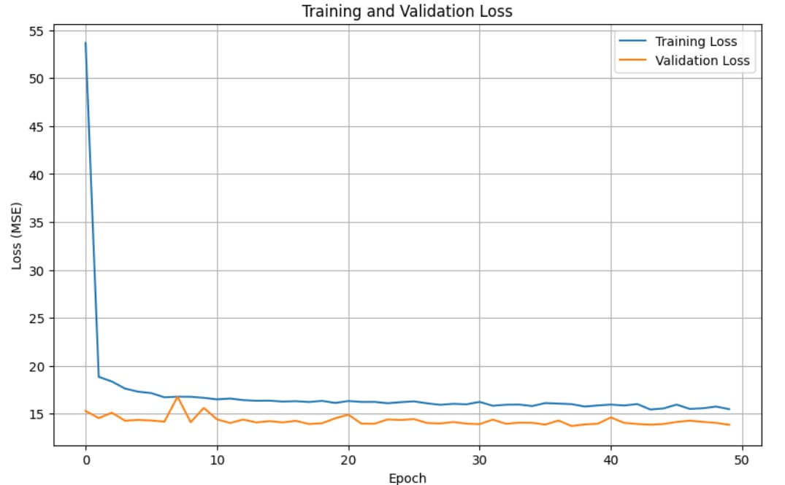
Result Analysis
14

Slide 16
Conclusion
15
Effectiveness of Temporal CNN
Opportunities for Enhancement
Impact on Urban Mobility

Slide 17
16
Thank You!
We respect your valuable time
If you have any questions, please let us know

